Slide 1
Internship Summary
Sukrit Tripathi
12/17/2025

Slide 2
Overview
My Internship Journey
5 Strategic Initiatives
Prompt Wizard | MIAdmin/NimiApp | LLM Evaluation | AR GenAI Summary | CRD | Attrition Forecasting
Key Contributions
Innovated agentic AI features for prompt optimization
Modernized authentication infrastructure (OAuth → Graph API)
Designed statistical frameworks for LLM hyperparameter analysis
Automated executive summary generation from forecast data
Researched chunking strategies to improve document comparison results
Core Focus Areas
GenAI/LLM Integration • Statistical Analysis • Process Automation

Slide 3
Prompt Wizard: Advanced GenAI Summarization Tool
The Challenge: VertexAI limitations in file handling and user control identified by Product Owners
Core Innovations
Enhanced File Management
  Multi-format Support: PDF, DOCX, TXT, XLSX, CSV, JSON
  Optimized Parsing: Convert all formats to text for maximum token efficiency
  Image-based PDF Extraction: Gemini 2.5 Pro with parallel processing for speed
  Greater Capacity: Handle more files than VertexAI baseline
User Control & Integration
  Hyperparameter Toggles: Seed, Temperature, Top-p for fine-tuned outputs
  Email Integration: Direct result delivery to recipients
  Cloud Persistence: GCS bucket storage with user-specific folders (prompts, models, results)
Agentic Features
  Improve Prompts: - Interactive chatbot for prompt creation and refinement of Prompts
  LLM Evaluations: Simultaneously tests prompts across multiple LLMs with automated scoring (e.g., Google Semantic Similarity)
  Prompt Transformation: Cross-LLM prompt transformation with reinforcement learning; user-configurable iterations and threshold scores
  Impact: Complete end-to-end GenAI workflow from file upload to result delivery

Slide 4
MIAdmin/NimiApp - Infrastructure & Feature Development
URGENT (Completed) - Microsoft Authentication
  Microsoft deprecated OAuth → immediate migration required
  Implemented Graph API with Secret Manager
  Zero downtime transition
HIGH PRIORITY (Completed) - Data Quality & Flexibility
  Resolved missing transcript errors (FactSet event types)
  Enhanced lookback period flexibility for multi-timeframe companies
  Built earnings scheduling feature (FactSet API integration)
INFRASTRUCTURE (In Progress) - Modernization
  Transferred prompts from a python file storage to VertexAI prompt management system
  Created SMAPI endpoints for miadmin application
  Integration of evaluation framework Mipy package with SMAPI template
STRATEGIC (In Progress) - Dependency Reduction Initiative
  Eliminating hardcoded company variables
  SharePoint Excel sheet + automated data pulls
  Transferring full control to Product Owners
  Goal: Reduce Data Science team maintenance burden

Slide 5
LLM Evaluation & Statistical DOE
Research Scope: Conducted comprehensive evaluation and statistical analysis of LLM performance across models and configurations
Design of Experiments (DOE) Studies
Seed Effect Analysis
  Tested fixed vs. random seed settings on Gemini 2.5 Pro and GPT-5
  Evaluated output consistency for identical prompts and inputs
  Finding: Quantified reproducibility impact
Hyperparameter Impact Study (180+ experimental runs)
  Gemini 2.5 Pro: Temperature, Top-p, Top-k, Thinking effort
  GPT-5: Reasoning and Verbosity parameters
  Analysis: JMP variability charts showing parameter importance
  Outcome: Predictive models to optimize hyperparameter selection for desired results. Requires more runs to get better results from modelling
Evaluation Framework Projects
Module Evaluation
  Performed LLM evaluation on Sreekar's Module for NimiApp companies
  Compared Gemini vs. GPT across multiple metrics
Framework Testing
  Tested Brandon & Justin's Evaluation Framework template with NimiApp results
  Next: Integration of Brandon's mypy package with SMAPI template

Slide 6
Account Receivable GenAI Summary
Project Goal: Automate executive summary generation for AR forecasts
🔬 Research Phase
  Investigated available cash collection data sources
  Determined organizational level requirements (overall, supervisor, analyst)
🏗️ SQL Architecture with CTEs
  Why CTEs: Modular design, readable queries, efficient execution
  What I Built:
    Variance driver extraction logic
    Statistical breakdown calculations
    Payer-level aggregations
    Document-level detail capture
Key Innovation: Structured CTE outputs to optimize LLM token usage and interpretation
Prompt Engineering
  Developed prompt templates for each summary category
  Iterative refinement cycle:
    Initial prompt → LLM output → Quality assessment → Prompt adjustment → Repeat
⚙️ Semi-Automated Pipeline
Integrated components: CTE execution → LLM processing → User delivery
Result: Completed POC of the summaries and handed it over to the Data Engineering team to scale the operation

Slide 7
CRD
Project Goal: Compare 2 documents and return an excel with all identified differences
  Problem: Existing app performed well in most cases; however, opportunities exists to enhance chunking precision and section title alignment
  Research & Development:
  Started from first principles: investigated multiple libraries for data extraction
  Explored various document chunking methods to improve section boundary detection
  Developed two Streamlit apps:
    App 1: Data extraction using multiple researched methods with section title extraction capability
    App 2: Step-by-step comparison with downloadable results for iterative improvement analysis
  Key Exploration: HTML-based section title extraction for intelligent chunking (from start of one section to beginning of next section title)

Slide 8
Attrition Model Headcount - Forecasting Enhancement
Attrition Model: Enhanced Forecasting for Workforce Planning
Objective: Improve attrition prediction accuracy to support next-year headcount planning for David and Bharath
Results
  Delivered improved prediction accuracy for next-year attrition forecasts
  Built 3 SMAPI (FastAPI) endpoints which extracts snowflake data, runs model and produces output excel

Slide 9
Key Achievements Summary
Projects Delivered
  5 Major Initiatives: Prompt Wizard | MIAdmin/NimiApp | Attrition Forecasting | LLM Evaluation | AR GenAI
  1 Research Area: Snowflake Agents & Cortex Analyst exploration
Technical Contributions
GenAI & LLM Innovation
  Engineered agentic features (prompt improvement, multi-LLM evaluation, cross-LLM transformation)
  Conducted 180+ experimental runs analyzing hyperparameter impacts
  Designed automated LLM evaluation framework
  Built GenAI-powered executive summary pipeline
Infrastructure & Security
  Migrated critical authentication (OAuth → Graph API) on urgent deadline
  Implemented Secret Manager for secure credential storage
  Developed cloud integration (GCS user-specific folders, SharePoint automation)
Data Engineering & Analytics
  Enhanced forecasting models (XGBoost, ARIMA comparative analysis)
  Built semi-automated data pipelines reducing team dependencies
Technologies Mastered
Gemini 2.5 Pro • GPT-5 • Microsoft Graph API • FactSet API • GCS • SQL/CTEs • JMP • Python • SharePoint
Impact Themes
Automation • Security • Data-Driven Decisions • AI Innovation • Dependency Reduction

Slide 10
Skills Developed
AI/ML Engineering
  Prompt Engineering & Optimization
  Agentic AI Development
  LLM Evaluation Frameworks
Performance & Optimization
  Fast LLM Responses (Chunking Strategies)
  Tokenization Optimization
  FastAPI Development (SMAPI)
Analytics
  Statistical Modeling
  Design of Experiments
Professional
  Cross-Functional Collaboration • Problem-Solving • Multi-Project Delivery

Slide 11
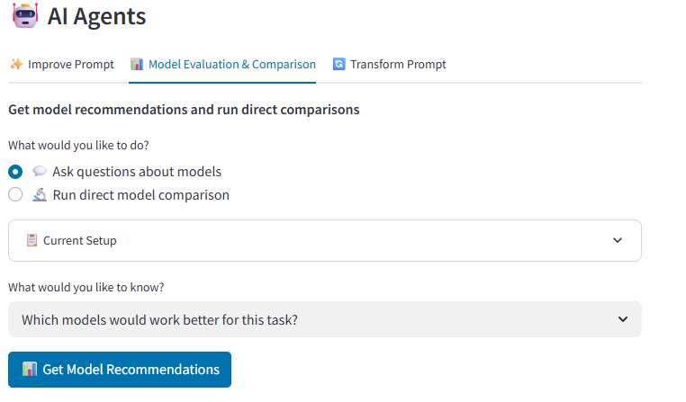
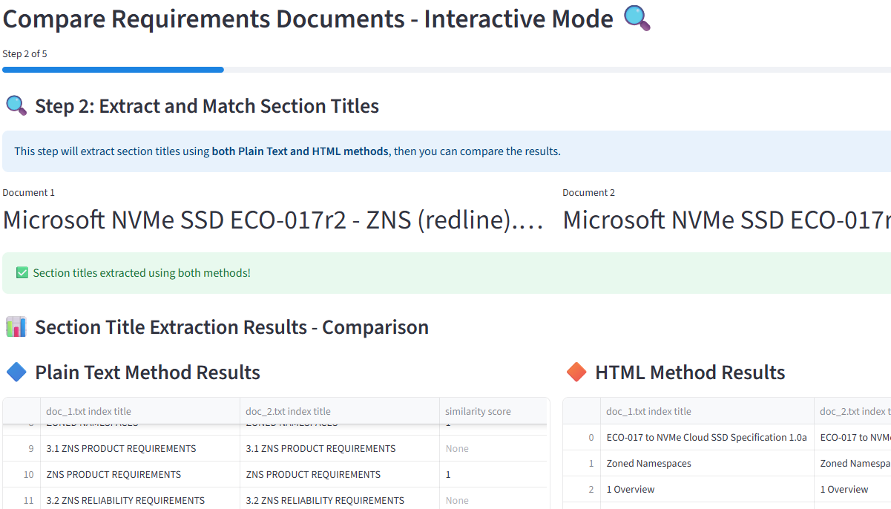
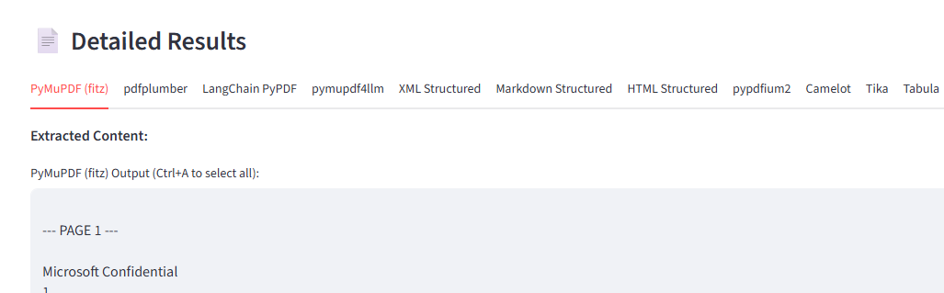
Research & Development
Prompt Wizard (Agentic Features)
  Problem: Helps users save time on prompt improvement, multi-model evaluation, and iterative optimization - building a one-stop shop
  Agents Developed:
  Agent 1: Prompt Writer/Improver - Interactive chatbot for prompt creation and refinement
  Agent 2: Model Evaluator - Simultaneously tests prompts across multiple LLMs with automated scoring (e.g., Google Semantic Similarity)
  Agent 3: Prompt Transformer - Cross-LLM prompt transformation with reinforcement learning; user-configurable iterations and threshold scores
  Future Scope: Root Agent Orchestrator - Master chatbot that uses Agents 1-3 as tools and autonomously decides which agent to deploy based on context
Document Comparison (CRD)
  Problem: Existing app performed well in most cases; however, opportunities exists to enhance chunking precision and section title alignment
  Research & Development:
  Started from first principles: investigated multiple libraries for data extraction
  Explored various document chunk
  ng methods to improve section boundary detection
  Developed two Streamlit apps:
    App 1: Data extraction using multiple researched methods with section title extraction capability
    App 2: Step-by-step comparison with downloadable results for iterative improvement analysis
  Key Exploration: HTML-based section title extraction for intelligent chunking (from start of one section to beginning of next section title)

Slide 12
Development & Support
1. MIAdmin/NimiApp
  SuppoSharePoint automation
  Built multiple SMAPI (FastAPI) endpoints serving streamlit functionalities with training and support from Justin, Siddharth, and Brandon
2. Attrition Model Headcount
  Supported David in enhancing forecasting accuracy
  Built 3 SMAPI (FastAPI) endpoints which extracts snowflake data, runs model and produces output excel
3. AR GenAI Summary
  Supported Kristina in developing semi-automated pipeline using SQL/CTEs to extract variance drivers and optimize LLM token usage
  Engineered iterative prompt refinement rted Jesse and Ikhlas in migrating authentication (OAuth → Graph API), resolving FactSet integration bugs, and reducing dependencies through process for end-to-end executive summary generation
4. Prompt Wizard (Core Features)
  Supported the team with multi-format file handling (PDF, DOCX, CSV, JSON) with optimized parsing and image-based PDF extraction using Gemini 2.5 Pro
  Built hyperparameter controls, email delivery, and GCS cloud storage with user-specific folders for security
5. LLM Evaluation & Statistical DOE
  Supported DaRon in conducting 180+ experimental runs analyzing hyperparameters (Temperature, Top-p, Top-k) and seed effects across Gemini 2.5 Pro and GPT-5
  Performed statistical analysis using JMP variability charts and tested evaluation frameworks for NimiApp integration

